Slide 1


Slide 2


Slide 3


Slide 4
Meet Our Team
David Giard
David Washington
Technical Evangelist
Doris Chen
Director of Technical Evangelism
Sr. Technical Evangelist
Deanna Sturgell
Community Evangelist
Kevin Leung
Gabrielle Crevecoeur
Technical Evangelist
Technical Evangelist
Jennifer Marsman
Principal Software Development Engineer
Kristin Naes
Marketing Coordinator

Slide 5
Meet Our Team
Sarah Sexton
Community Evangelist
Tierney Wixted
Technical Evangelist
Lisa Anderson
Community Program Manager
Matt Winkler
Cecil Phillip
Cloud Developer Advocate
AI&R Program Manager
Scott Addie
Senior Content Developer

Slide 6


Microsoft Sponsor Lounge
Stop by our lounge space in the sponsor expo to connect with any Microsoft speakers post-session, and check out Microsoft technology demos from our Technical Evangelists & MVP’s.

Slide 7
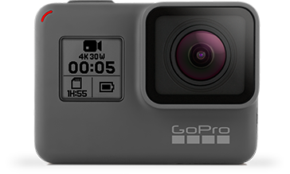
Complete the below survey for a chance to win a GoPro Hero 5
https://aka.ms/ThatConf17

Slide 8
Microsoft Sessions: Monday August 7th
Making Apps More Human with Microsoft Cognitive Services 10:30 AM | Room C Matthew Soucoup Breaking into Bots 1:00 PM | Room D Gabrielle Crevecoeur Implementing LUIS in Node.js Microsoft Bot Framework 1:00 PM | Wisteria Sarah Sexton From Legacy MVC to Modern MVC: An ASP.NET Core Migration Path 1:00 PM | Tamarind Scott Addie 0 to 60 with Node, Express & Mongo 2:30 AM | Room E Tim Rayburn | Machine Learning, Artificial Intelligence, Agents, and Bots: True stories from the trenches 2:30 PM | Room G Matt Winkler Intro to Machine Learning: Predict Who Survives the Titanic 4:00 PM | Guava Jennifer Marsman Make a 3D game in an Hour: Unity Intro. 4:00 PM | Room C Dan Sagmiller AR/MR/VR Development Lab 7:00 PM | Room B Greg Levenhagen

Slide 9
Microsoft Sessions: Tuesday August 8th
A Developers Safari into the Internet of Things, with Pi 10:30 AM | Room F Chris Pietschmann All Requests are Asynchronous 10:30 AM | Portia Michael Perry Domain Driven Design: The Good Parts 10:30 AM | Room E Jimmy Bogard OH NO! Your agile team just found their way into the Fire Swamp 10:30 AM | Room D Angela Dugan Pokemon GO MAKE A WEBSITE! 1:00 PM | Aloeswood Tierney Wixted | Cloud Battle Stories 1:00 PM | Portia Kevin Leung Concurrent Programming in .NET 1:00 PM | Room F Jason Bock Go Serverless with Azure Functions 1:00 PM | Room B Eric Boyd Packing Your Camping Software In A Docker Trunk 1:00 PM | Room E Lee Brandt What's New in TypeScript 2:30 PM | Room B Doris Chen Augmented Eyes = Azure Cognitive Services + HoloLens 4:00 PM | Guava Lance Larsen

Slide 10
Microsoft Sessions: Wednesday August 9th
(Micro)Service Discovery Patterns with ASP.NET Core 10:30 AM | Guava Cecil Philip Building artificial intelligence into your Node.js apps 12:15 PM | Room B David Washington Building Powerful Applications with Angular and TypeScript 1:00 PM | Wisteria David Giard F# Type Providers 1:00 PM | Guava Chris Gardner

Slide 11
Build with Microsoft Tech
Explore developer tools, platforms, and API’s
docs.microsoft.com

Slide 12



From Legacy MVC to Modern MVC An ASP.NET Core Migration Path
Senior Content Developer @ Microsoft | @Scott_Addie

Slide 13
Agenda
Upgrade Paths
Assembly Portability
Dependency Injection
App Settings
Package Management
Bundling & Minification

Slide 14


You Are Here
ASP.NET 4.6
.NET Framework 4.6
Operating Systems
Editors VS 2015
Web Server IIS
Distribution OS
Notes:
ASP.NET introduced in 2002
Best candidate for ASP.NET Core = MVC or Web API

Slide 15


Determine Your Upgrade Path
ASP.NET Core 1.1
.NET Framework 4.7
.NET Core 1.1
net47
netcoreapp1.1
Operating Systems
Operating Systems
Editors VS 2015+, VS Code*
Editors VS 2015+, VS Code VS Code,
VS for Mac
Web Server IIS, Kestrel
Web Server IIS, Kestrel, HttpSys Nginx, Kestrel
Distribution OS
Distribution w/ or w/o App
* Debugging not currently supported
Notes:
.NET Core App Deployment Options
Framework-dependent
Self-contained
IIS reverse proxies HTTP to Kestrel
Kestrel doesn’t provide port 80/443 forwarding
Treat Kestrel just as your app server; not yet blessed as public-facing edge server
HttpSys
Supports some Windows-specific features that Kestrel does not (e.g., Windows auth)
Use if you want to host a service in your own process, and you don’t want to use IIS, but you still need Windows auth
You can host multiple domains on the same port & IP (this is how IIS does it)
Popular APIs missing in .NET Core:
System.DirectoryServices
No LDAP / AD support
System.Drawing

Slide 16
The Value Proposition of .NET Core
X-plat
Open source
Everything is a dependency (cafeteria plan)
Broader container support
Cloud-optimized
Notes:
Containers
No machine-wide installation
App isolated from machine-level patches

Slide 17
.NET Core Tooling Considerations
VS Code, VS 2015 (Preview 2 Tooling)
VS Code, VS 2017, VS for Mac (RTM Tooling)
project.json
*.xproj
1-way
*.csproj
> dotnet migrate

Slide 18
Assembly Portability

Slide 19
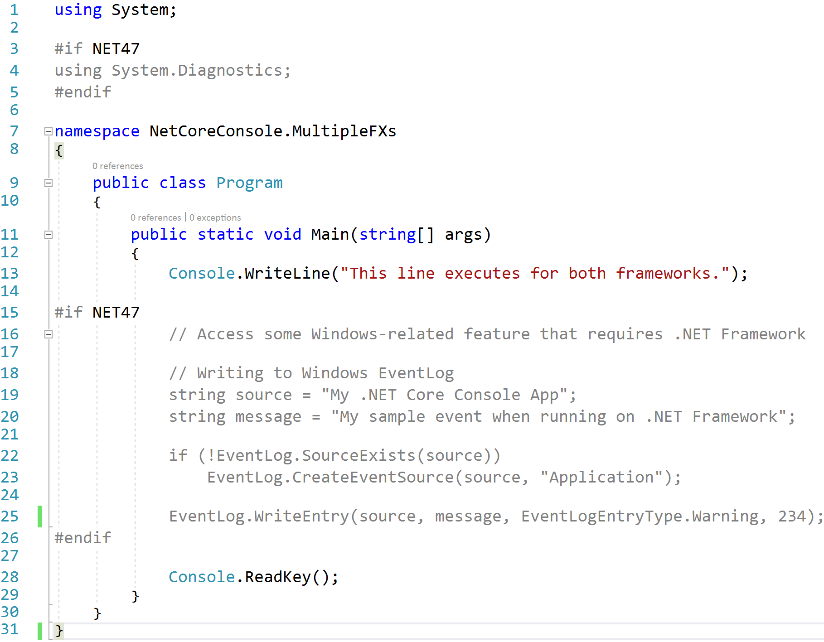
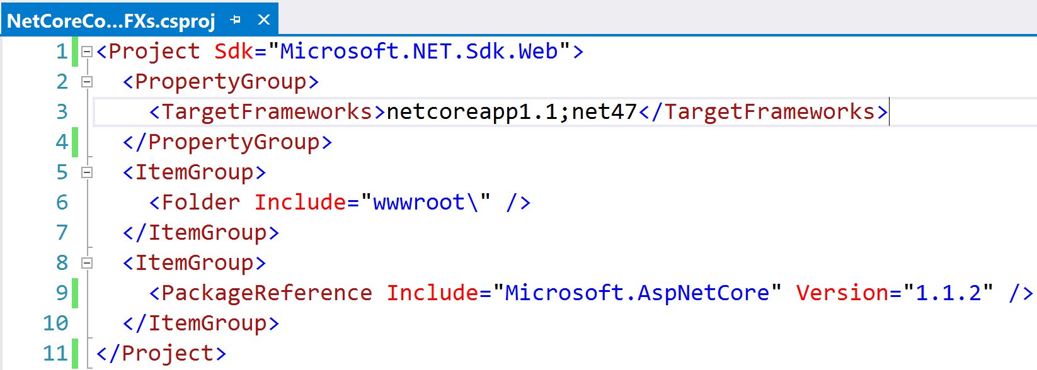
Precompiler Directives
Notes:
- 1st TFM is what VS runs against (for now)

Slide 20
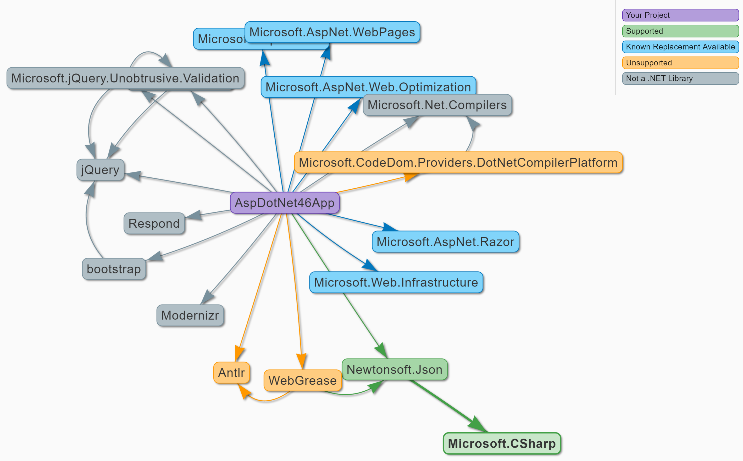
Portability Analyzers I Can Has .NET Core (https://icanhasdot.net/)
Notes:
VS 2017 CSPROJ projects NOT supported
NuGet & Paket supported

Slide 21
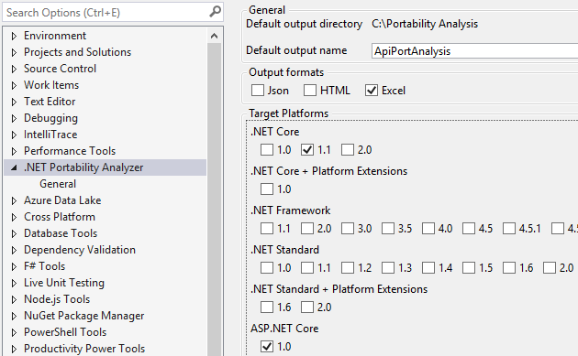
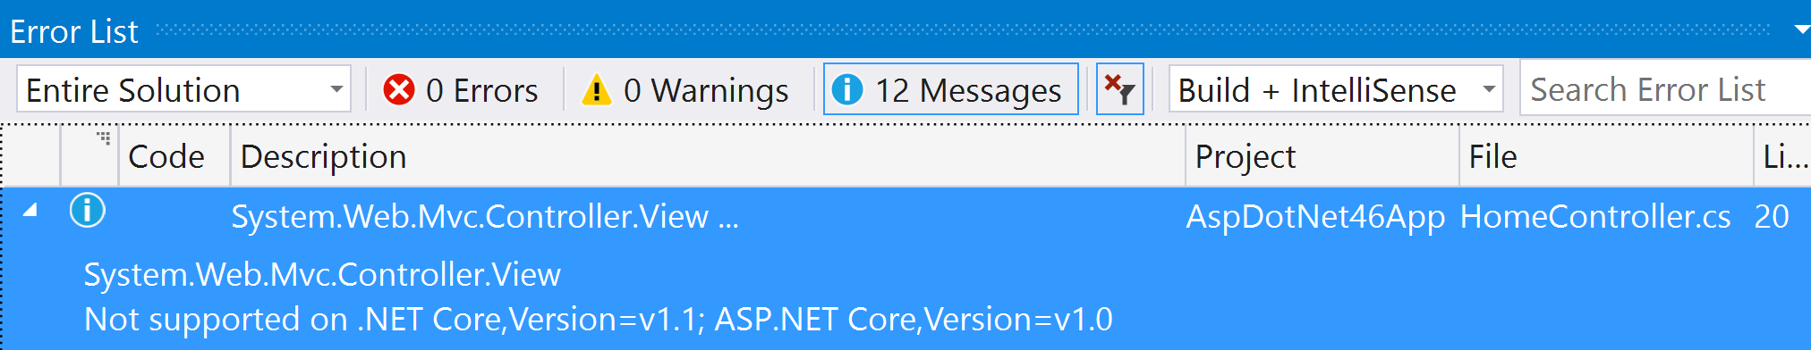
Portability Analyzers .NET Portability Analyzer (http://bit.ly/2llzOPS)
Notes:
Target .NET Framework 4.6.1+ as long as possible before switching to .NET Core
Missing APIs available in .NET 4.6.1
.NET Standard 2.0 introduces ~20k new APIs (e.g., DataTable, DataSet)
.NET Core 2.0 implements .NET Standard 2.0
- ~5k more APIs in .NET Core 2.0

Slide 22




.NET Portability Analyzer How It Works
Microsoft.*.dll
Mono.*.dll
System.*.dll
Assemblies
Assemblies
{ … }
{ … }
ApiPort VS Extension
Portability Service

Slide 23
Dependency Injection

Slide 24
Native IoC Container Constructor Injection
Startup.cs
public void ConfigureServices(IServiceCollection sc) { sc.AddTransient<IAttendeeService, AttendeeService>(); // Add framework services. sc.AddMvc(); }
AttendeesController.cs
public class AttendeesController : Controller { private readonly IAttendeeService _attendeeSvc; public AttendeesController( IAttendeeService attendeeSvc) { _attendeeSvc = attendeeSvc; }

Slide 25
Autofac Constructor Injection
AutofacModule.cs
public class AutofacModule : Module { protected override void Load(ContainerBuilder cb) { cb.RegisterType<AttendeeService>() .As<IAttendeeService>(); } }
Startup.cs
public IServiceProvider ConfigureServices(IServiceCollection sc) { // Add framework services. sc.AddMvc(); var containerBuilder = new ContainerBuilder(); containerBuilder.RegisterModule<AutofacModule>(); containerBuilder.Populate(sc); var container = containerBuilder.Build(); return container.Resolve<IServiceProvider>(); }
AttendeesController.cs
public class AttendeesController : Controller { private readonly IAttendeeService _attendeeSvc; public AttendeesController( IAttendeeService attendeeSvc) { _attendeeSvc = attendeeSvc; }

Slide 26
3rd Party DI Frameworks
More feature rich
Extensible lifetimes (per thread, per resolve cycle, etc.)
Auto wiring of types in assembly
Resolve Lazy<T> instances of registered types
Recommendation:
Native IoC for greenfield development
3rd party IoC to migrate existing investment

Slide 27
App Settings

Slide 28
XML is Abandoned for JSON
web.config
appsettings.json
<configuration> <appSettings> <add key="webpages:Version" value="3.0.0.0" /> <add key="webpages:Enabled" value="false" /> <add key="ClientValidationEnabled" value="true" /> <add key="UnobtrusiveJavaScriptEnabled" value="true" /> <add key="AttendeeInfo:FirstName" value="Scott" /> <add key="AttendeeInfo:LastName" value="Addie" /> <add key="AttendeeInfo:IsSpeaker" value="true" /> </appSettings>
{ "Logging": { "IncludeScopes": false, "LogLevel": { "Default": "Debug", "System": "Information", "Microsoft": "Information" } }, "AttendeeInfo": { "FirstName": "Scott", "LastName": "Addie", "IsSpeaker": true } }

Slide 29
Retrieving App Settings Strongly-typed IOptions<T>
Startup.cs
public void ConfigureServices( IServiceCollection sc) { sc.AddOptions(); sc.Configure<Attendee>(Configuration .GetSection("AttendeeInfo")); }
appsettings.json
Attendee.cs
{ "AttendeeInfo": { "FirstName": "Scott", "LastName": "Addie", "IsSpeaker": true } }
public class Attendee { public string FirstName {get; set;} public string LastName {get; set;} public bool IsSpeaker {get; set;} }
AttendeesController.cs
Map
public class AttendeesController : Controller { private readonly Attendee _attendee; public AttendeesController( IOptions<Attendee> attendee) { _attendee = attendee.Value; }
Inject
AttendeesController.cs
var firstName = _attendee.FirstName;
Retrieve

Slide 30
Retrieving App Settings IConfiguration.GetValue
Startup.cs
public void ConfigureServices( IServiceCollection sc) { sc.AddSingleton<IConfiguration>( Configuration); }
appsettings.json
AttendeesController.cs
{ "AttendeeInfo": { "FirstName": "Scott", "LastName": "Addie", "IsSpeaker": true } }
public class AttendeesController : Controller { private readonly IConfiguration _config; public AttendeesController( IConfiguration config) { _config = config; }
Inject
Retrieve
AttendeesController.cs
var firstName = _config.GetValue<string>( "AttendeeInfo:FirstName");

Slide 31
Package Management

Slide 32
NuGet Changes
packages.config is dead
VS 2015 Update 1+ ← project.json
VS 2017 ← *.csproj w/ <PackageReference />
OLD NEW
<.sln_folder>\packages %USERPROFILE%\.nuget\packages
Notes:
- repositories.config goes away

Slide 33
NuGet Centralized Packages Repository
NuGet Cache
ASP.NET Core App
ASP.NET Core App
ASP.NET Core App
Microsoft.AspNetCore.Mvc
Microsoft.EntityFrameworkCore
Newtonsoft.Json
Notes:
Assume this is the CI server
Per user package cache (service account runs builds)

Slide 34
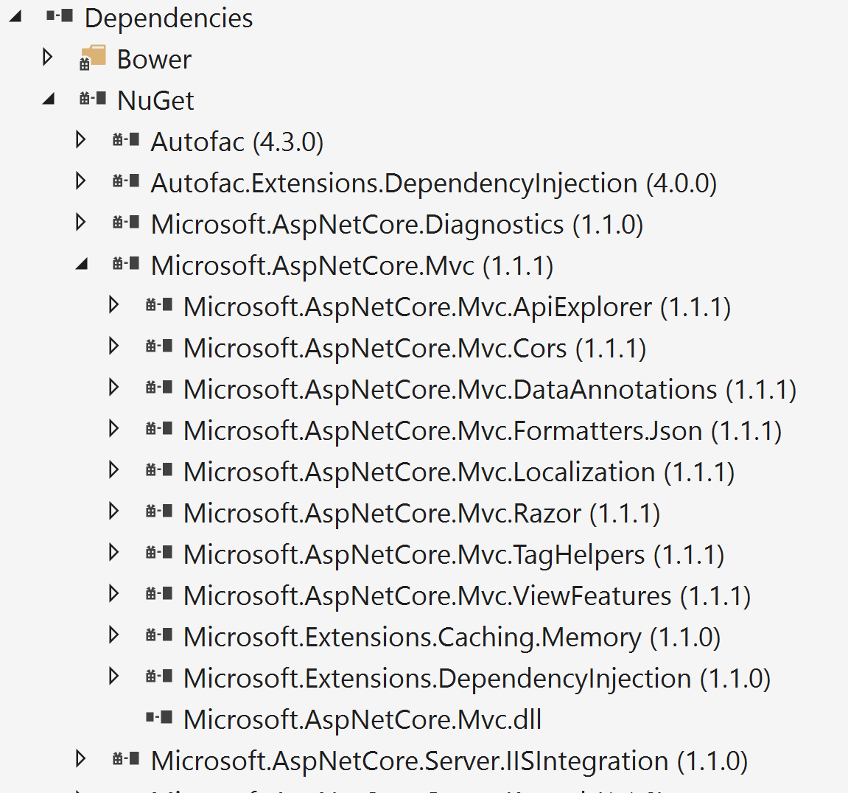
NuGet Transitive References
<project_name>.csproj
<ItemGroup> <PackageReference Include="Microsoft.AspNetCore.Mvc" Version="1.1.1" />

Slide 35


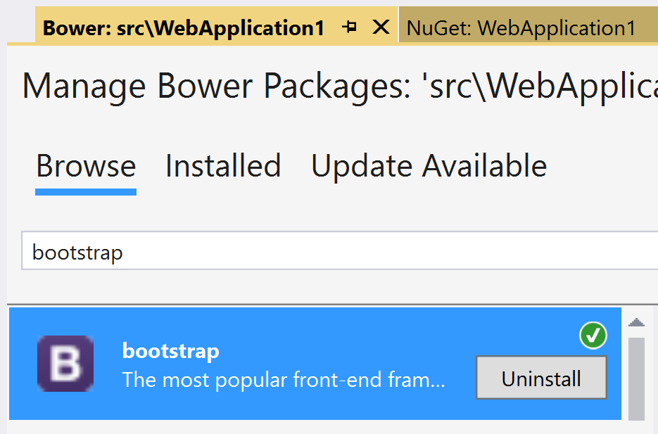
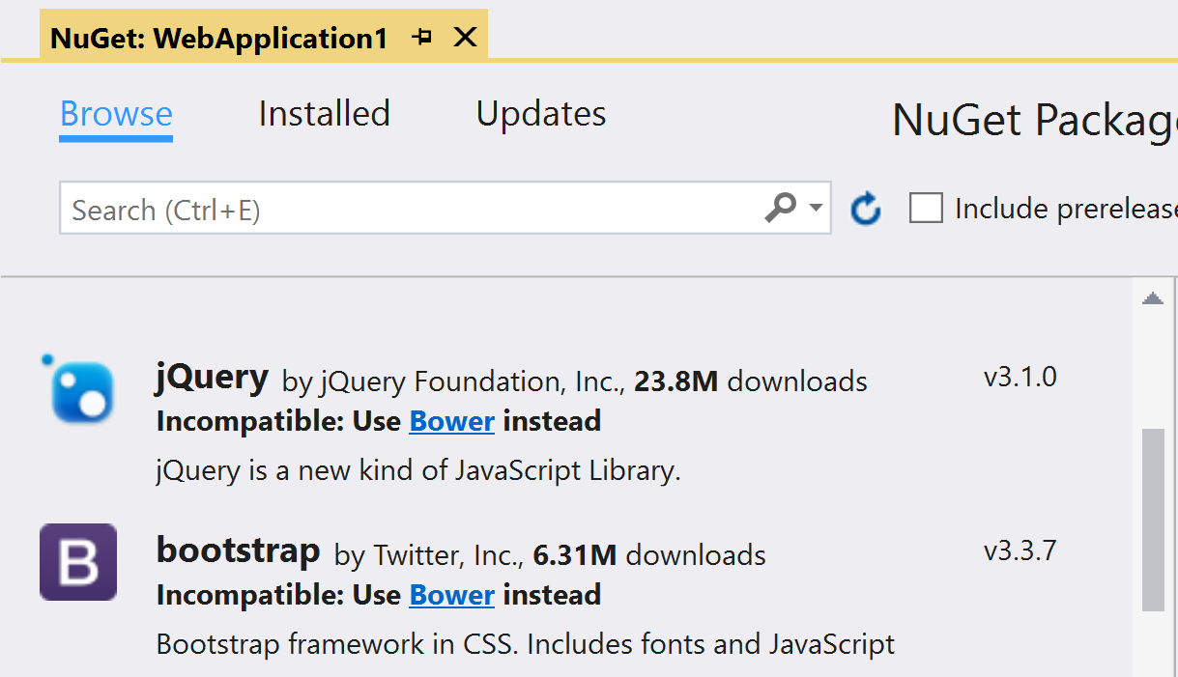
Bower Static Asset Acquisition
Manage NuGet Packages
Manage Bower Packages
Notes:
- Content files not supported in ASP.NET Core projects

Slide 36
Bundling & Minification

Slide 37
A Look at Where We’ve Been
Microsoft.AspNet.Web.Optimization
Grunt
Gulp
ASP.NET 4.5
NuGet
C# or VB.NET
On-the-fly processing by web server
ASP.NET 5 Beta
npm
JavaScript
Process before deploying
ASP.NET Core 1.0 RC
npm
JavaScript
Process before deploying

Slide 38

The Way Forward
bundleconfig.json
[ { "outputFileName": "wwwroot/css/site.min.css", "inputFiles": [ "wwwroot/css/site.css" ] }, { "outputFileName": "wwwroot/js/site.min.js", "inputFiles": [ "wwwroot/js/site.js" ], "minify": { "enabled": true, "renameLocals": true }, "sourceMap": false } ]
BundlerMinifier.Core
ASP.NET Core 1.0 RTM
NuGet
JSON
Process before deploying
Notes:
Bundler & Minifier added to Preview 2 Tooling
Uses a .NET Core port of AjaxMin for minification, called NUglify

Slide 39
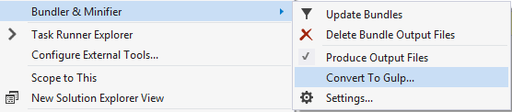
…but Gulp still has its place
Bundler & Minifier extension
Reserve for complex workflows
Notes:
Reasons for Gulp Replacement:
Publishing was taking a long time w/ Gulp & npm
npm had to install all of its packages
There were already enough new concepts in ASP.NET Core
Many customers don’t like having node_modules in their project
~1,500 files in node_modules folder
File ➔ New ➔ Project was quicker w/o npm

Slide 40

A Supplementary Resource
Telerik Developer Network article
Migration to ASP.NET Core: Considerations and Strategies
http://bit.ly/2lHxgyb

Slide 41





Thank you!
@Scott_Addie
scottaddie.com
github.com/scottaddie
/DotNetCoreSampleApp
/slide-decks

